Slide 1
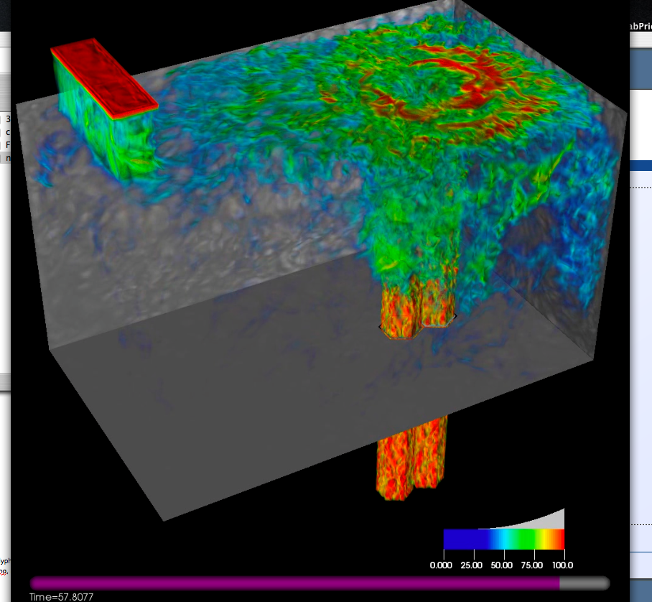
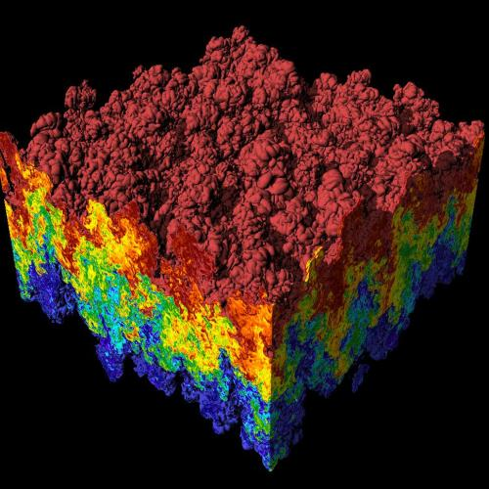
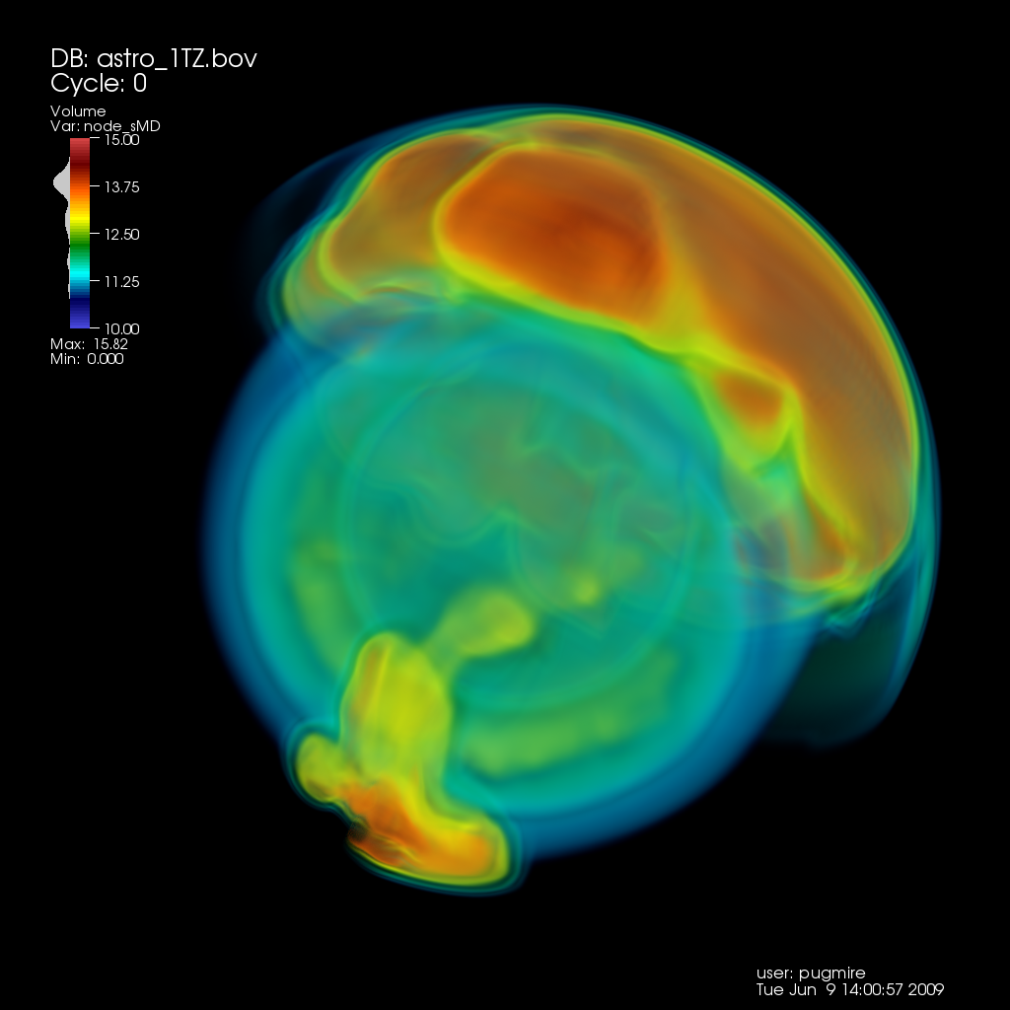
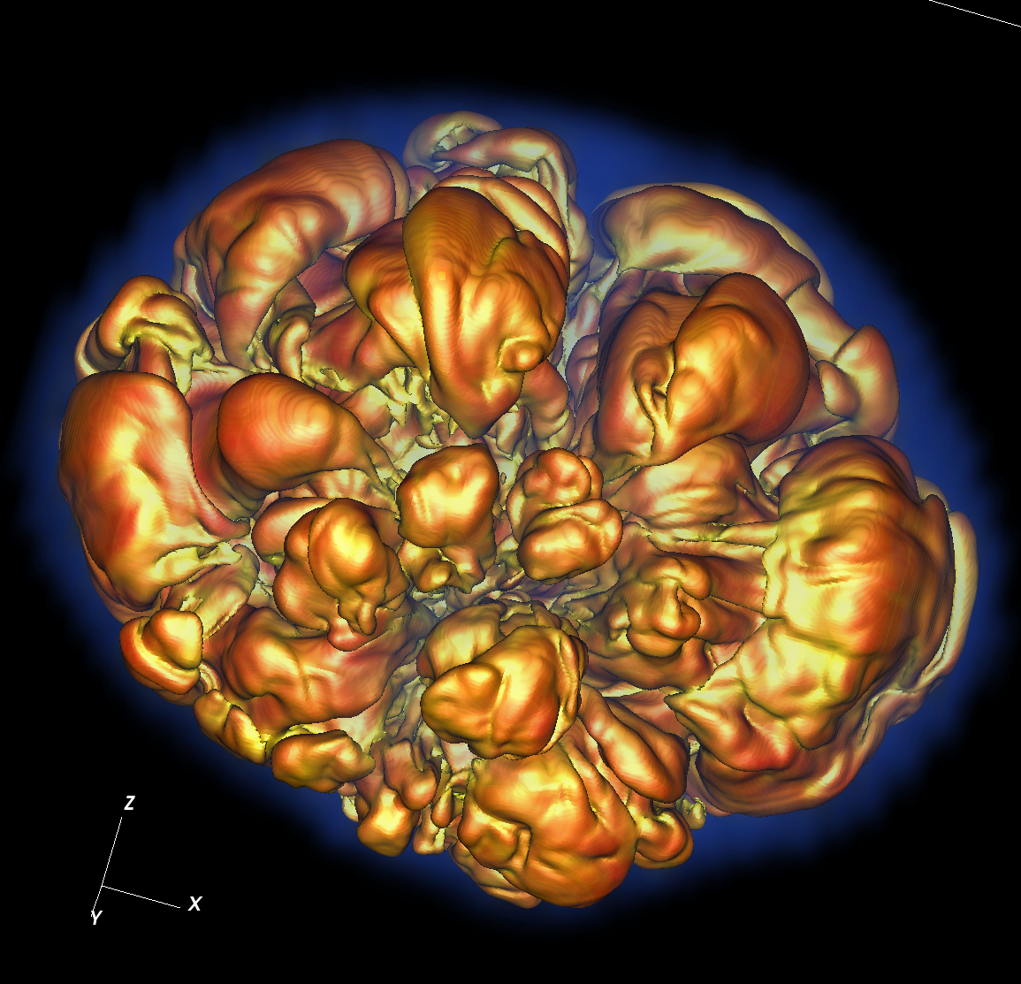
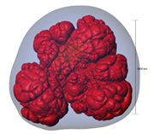
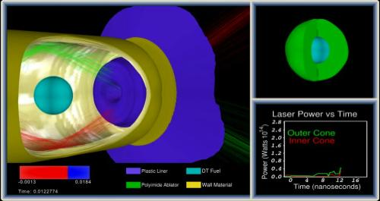
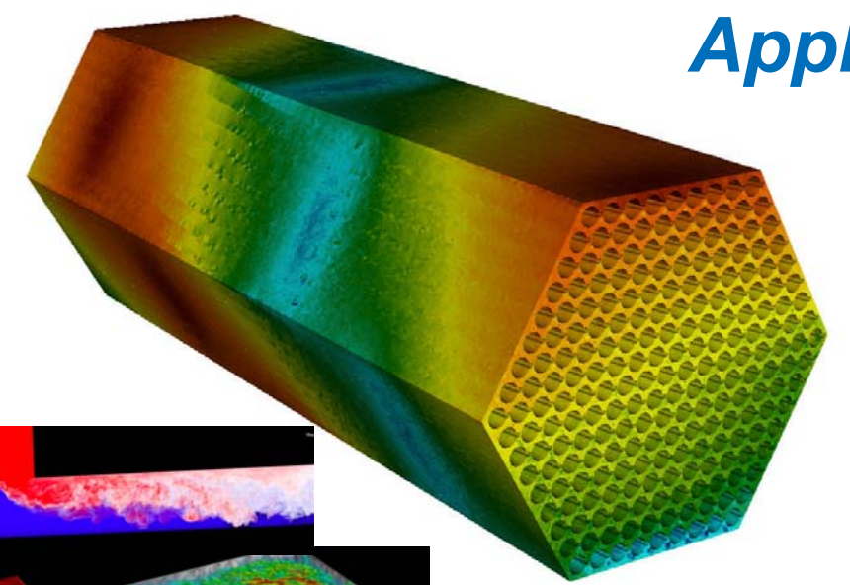
CIS 441/541: Introduction to Computer Graphics Lecture 14: tests, interactors, raytracing, collision detection, animation
March 7th, 2019
Hank Childs, University of Oregon

Slide 2
Talk about the test

Slide 3
Project G
Blender
WebGL #1
WebGL #2
CUDA
Bezier
Computer Vision
Shaders

Slide 4
Schedule
Upcoming:
Project G Mass OH?
Live code project 1?

Slide 5
Late Passes
Will bring forms to final

Slide 6
Hank OH
Primary purpose of Hank’s OH is now to help with self-defined projects
Also can help with 1A-1F,2A,2B
Continues as Thurs/Fri 1130-1230

Slide 7
Transparent Geometry

Slide 8
Compositing and Blending
Ed Angel
Professor of Computer Science, Electrical and Computer Engineering, and Media Arts
University of New Mexico

Slide 9

Opacity and Transparency
Opaque surfaces permit no light to pass through
Transparent surfaces permit all light to pass
Translucent surfaces pass some light
translucency = 1 – opacity (α)
opaque surface α =1

Slide 10
Transparency
If you have an opaque red square in front of a blue square, what color would you see?
Red
If you have a 50% transparent red square in front of a blue square, what color would you see?
Purple
If you have a 100% transparent red square in front of a blue square, what color would you see?
Blue

Slide 11
(One) Formula For Transparency
Front = (Fr,Fg,Fb,Fa)
a = alpha, transparency factor
Sometimes percent
Typically 0-255, with 255 = 100%, 0 = 0%
Back = (Br,Bg,Bb,Ba)
Equation = (Fa*Fr+(1-Fa)*Br, Fa*Fg+(1-Fa)*Bg, Fa*Fb+(1-Fa)*Bb, Fa+(1-Fa)*Ba)

Slide 12
Transparency
If you have an 25% transparent red square (255,0,0) in front of a blue square (0,0,255), what color would you see (in RGB)?
(192,0,64)
If you have an 25% transparent blue square (0,0,255) in front of a red square (255,0,0), what color would you see (in RGB)?
(64,0,192)

Slide 13
Implementation
Per pixel storage:
RGB: 3 bytes
Alpha: 1 byte
Z: 4 bytes
Alpha used to control blending of current color and new colors

Slide 14
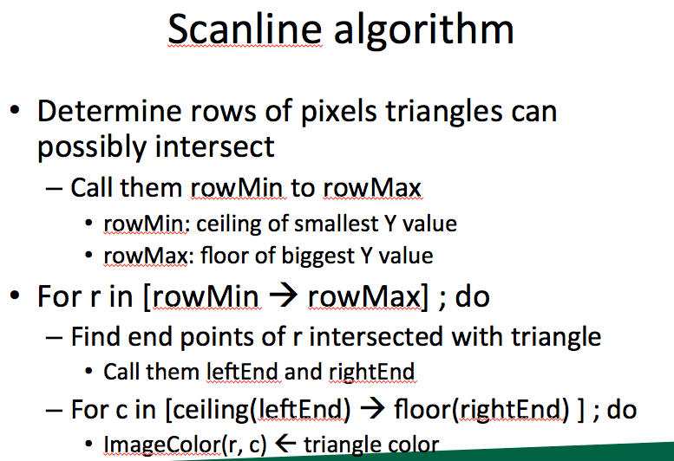
Vocab term reminder: fragment
Fragment is the contribution of a triangle to a single pixel

Slide 15
Examples
Imagine pixel (i, j) has:
RGB = 255/255/255
Alpha=255
Depth = -0.5
And we contribute fragment:
RGB=0/0/0
Alpha=128
Depth = -0.25
What do we get?
Answer: 128/128/128, Z = -0.25
What’s the alpha?

Slide 16
Examples
Imagine pixel (i, j) has:
RGB = 255/255/255
Alpha=128
Depth = -0.25
And we contribute fragment:
RGB=0/0/0
Alpha=255
Depth = -0.5
What do we get?
Answer: (probably) 128/128/128, Z = -0.25
What’s the alpha?

Slide 17
System doesn’t work well for transparency
Contribute fragments in this order:
Z=-0.1
Z=-0.9
Z=-0.5
Z=-0.4
Z=-0.6
Model is too simple. Not enough info to resolve!

Slide 18
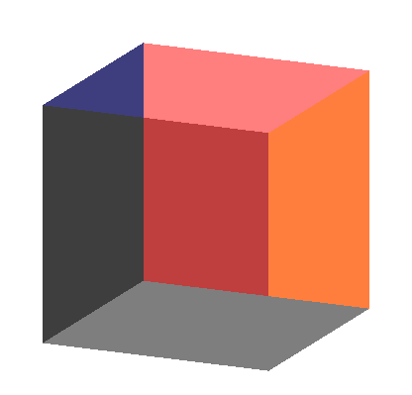
Order Dependency
Is this image correct?
Probably not
Polygons are rendered
in the order they pass
down the pipeline
Blending functions
are order dependent

Slide 19
How do you sort?
1) Calculate depth of each triangle center.
2) Sort based on depth
Not perfect, but good
In practice: sort along X, Y, and Z and use “dominant axis” and only do “perfect sort” when rotation stops

Slide 20
But there is a problem…
(0, 1, -0.4)
(0, 1.5, -0.4)
(-1, -1, -0.3)
(1, -1, -0.5)
(-2, -1.5, -0.5)
(2, -1.5, -0.3)

Slide 21
Depth Peeling
a multi-pass technique that renders transparent polygonal geometry without sorting
Pass #1:
render as opaque, but note opacity of pixels placed on top
treat this as “top layer”
save Z-buffer and treat this as “max”
Pass #2:
render as opaque, but ignore fragments beyond “max”
repeat, repeat…

Slide 22
Introduction to Ray Tracing
Dr. Xiaoyu Zhang
Cal State U., San Marcos

Slide 23
Classifying Rendering Algorithms
One way to classify rendering algorithms is according to the type of light interactions they capture
For example: The OpenGL lighting model captures:
Direct light to surface to eye light transport
Diffuse and rough specular surface reflectance
It actually doesn’t do light to surface transport correctly, because it doesn’t do shadows
We would like a way of classifying interactions: light paths

Slide 24
Classifying Light Paths
Classify light paths according to where they come from, where they go to, and what they do along the way
Assume only two types of surface interactions:
Pure diffuse, D
Pure specular, S
Assume all paths of interest:
Start at a light source, L
End at the eye, E
Use regular expressions on the letters D, S, L and E to describe light paths
Valid paths are L(D|S)*E

Slide 25
Simple Light Path Examples
LE
The light goes straight from the source to the viewer
LDE
The light goes from the light to a diffuse surface that the viewer can see
LSE
The light is reflected off a mirror into the viewer’s eyes
L(S|D)E
The light is reflected off either a diffuse surface or a specular surface toward the viewer
Which do OpenGL (approximately) support?

Slide 26
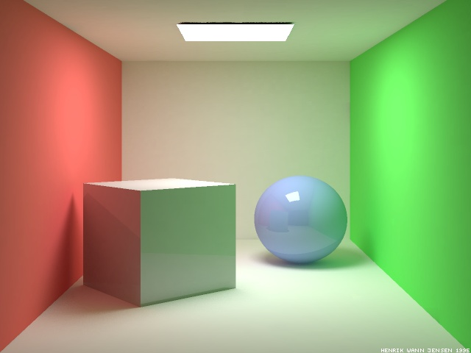
More Complex Light Paths
Find the following:
LE
LDE
LSE
LDDE
LDSE
LSDE
Radiosity Cornell box, due to Henrik wann Jensen,
http://www.gk.dtu.dk/~hwj, rendered with ray tracer

Slide 27
More Complex Light Paths
LE
LDDE
LSDE
LSE
LDSE
LDE

Slide 28
The OpenGL Model
The “standard” graphics lighting model captures only L(D|S)E
It is missing:
Light taking more than one diffuse bounce: LD*E
Should produce an effect called color bleeding, among other things
Approximated, grossly, by ambient light
Light refracted through curved glass
Consider the refraction as a “mirror” bounce: LDSE
Light bouncing off a mirror to illuminate a diffuse surface: LS+D+E
Many others
Not sufficient for photo-realistic rendering

Slide 29

Raytraced Images
PCKTWTCH by Kevin Odhner, POV-Ray

Slide 30
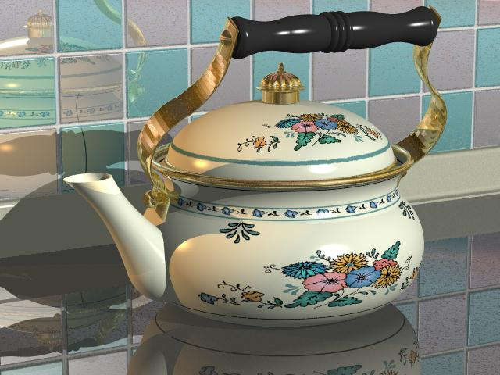
Kettle, Mike Miller, POV-Ray

Slide 31
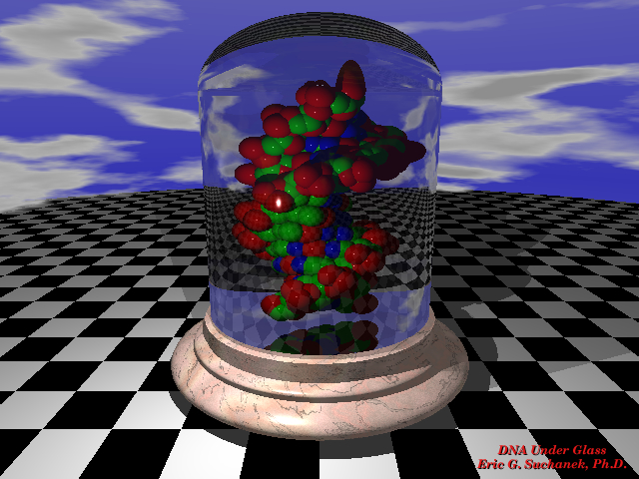

Slide 32

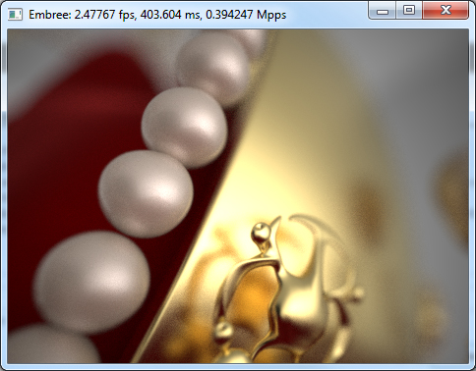
The previous slides now look like amateur hour…

Slide 33
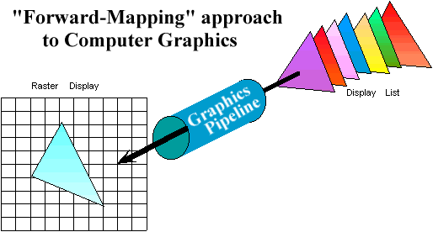
Graphics Pipeline Review
Properties of the Graphics Pipeline
Primitives are transformed and projected (not depending on display resolution)
Primitives are processed one at a time
Forward-mapping from geometrical space to image space

Slide 34
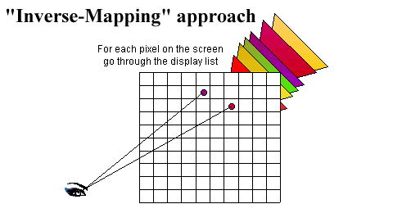
Alternative Approaches: Ray CASTING (not Ray TRACING)
Ray-casting searches along lines of sight, or rays, to determine the primitive that is visible along it.
Properties of ray-casting:
Go through all primitives at each pixel
Image space sample first
Analytic processing afterwards

Slide 35
Ray Casting Overview
For every pixel shoot a ray from the eye through the pixel.
For every object in the scene
Find the point of intersection with the ray closest to (and in front of) the eye
Compute normal at point of intersection
Compute color for pixel based on point and normal at intersection closest to the eye (e.g. by Phong illumination model).
t₀

Slide 36
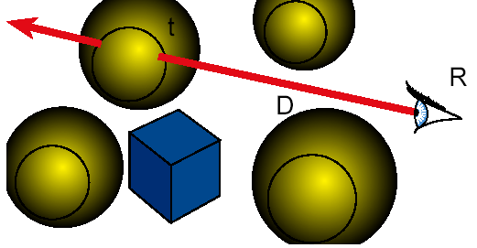
Ray Casting
Ray Cast ( Point R, Ray D ) {
foreach object in the scene
find minimum t>0 such that R + t D hits object
if ( object hit )
return object
else return background object
}

Slide 37
Raytracing
Cast rays from the eye point the same way as ray casting
Builds the image pixel by pixel, one at a time
Cast additional rays from the hit point to determine the pixel color
Shoot rays toward each light. If they hit something, then the object is shadowed from that light, otherwise use “standard” model for the light
Reflection rays for mirror surfaces, to see what should be reflected in the mirror
Refraction rays to see what can be seen through transparent objects
Sum all the contributions to get the pixel color

Slide 38
Raytracing
Shadow rays
Reflection ray
refracted ray

Slide 39
Recursive Ray Tracing
When a reflected or refracted ray hits a surface, repeat the whole process from that point
Send out more shadow rays
Send out new reflected ray (if required)
Send out a new refracted ray (if required)
Generally, reduce the weight of each additional ray when computing the contributions to surface color
Stop when the contribution from a ray is too small to notice or maximum recursion level has been reached

Slide 40
Raytracing Implementation
Raytracing breaks down into two tasks:
Constructing the rays to cast
Intersecting rays with geometry
The former problem is simple vector arithmetic
Intersection is essentially root finding (as we will see)
Any root finding technique can be applied
Intersection calculation can be done in world coordinates or model coordinates

Slide 41
Constructing Rays
Define rays by an initial point and a direction: x(t)=x₀+td
Eye rays: Rays from the eye through a pixel
Construct using the eye location and the pixel’s location on the image plane. X₀ = eye
Shadow rays: Rays from a point on a surface to the light.
X₀ = point on surface
Reflection rays: Rays from a point on a surface in the reflection direction
Construct using laws of reflection. X₀ = surface point
Transmitted rays: Rays from a point on a transparent surface through the surface
Construct using laws of refraction. X₀ = surface point

Slide 42
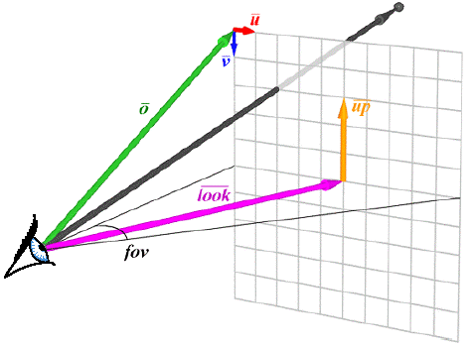
From Pixels to Rays

Slide 43
Ray Tracing Illumination
Recursive
Check for shadowing (intersection with object along ray (P,L))

Slide 44
The Ray Tree
N₃
T₃
R₂
Viewpoint
N₂
T₁
R₃
R₁
L₁
L₂
N₁
L₃
L₁
R₁
T₁
L₂
L₃
Eye
N_{i} surface normal
R_{i} reflected ray
L_{i} shadow ray
T_{i} transmitted (refracted) ray
Psuedo-code
R₂
R₃
T₃

Slide 45
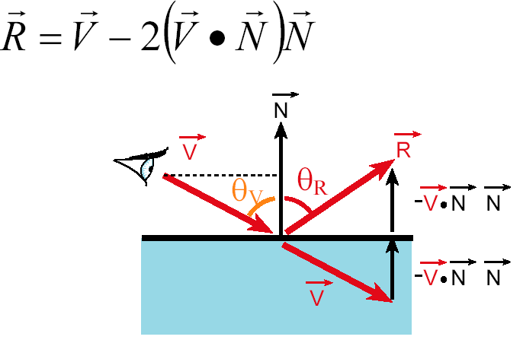
Reflection
Reflection angle = view angle

Slide 46
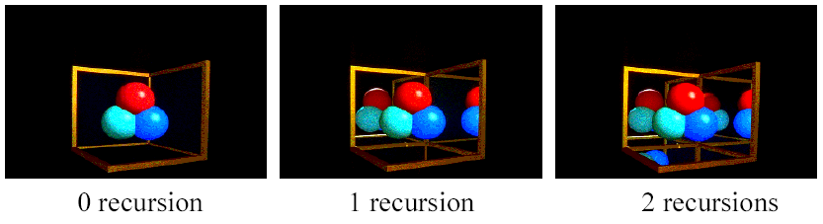
Reflection
The maximum depth of the tree affects the handling of refraction
If we send another reflected ray from here, when do we stop? 2 solutions (complementary)
Answer 1: Stop at a fixed depth.
Answer 2: Accumulate product of reflection coefficients and stop when this product is too small.

Slide 47
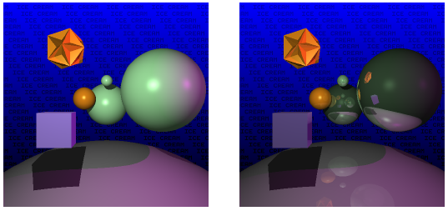
Reflection

Slide 48
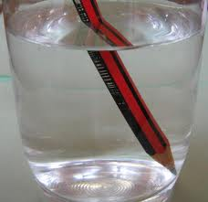
Refraction
Snell’s Law
Note that I is the negative of the incoming ray

Slide 49
Pseudo Code for Ray Tracing
rgb lsou; // intensity of light source
rgb back; // background intensity
rgb ambi; // ambient light intensity
Vector L // vector pointing to light source
Vector N // surface normal
Object objects [n] //list of n objects in scene
float Ks [n] // specular reflectivity factor for each object
float Kr [n] // refractivity index for each object
float Kd [n] // diffuse reflectivity factor for each object
Ray r;
void raytrace() {
for (each pixel P of projection viewport in raster order) {
r = ray emanating from viewer through P
int depth = 1; // depth of ray tree consisting of multiple paths
the pixel color at P = intensity(r, depth)
}
}

Slide 50
rgb intensity (Ray r, int depth) {
Ray flec, frac;
rgb spec, refr, dull, intensity;
if (depth >= 5) intensity = back;
else {
find the closest intersection of r with all objects in scene
if (no intersection) {
intensity =back;
} else {
Take closest intersection which is object[j]
compute normal N at the intersection point
if (Ks[j] >0) { // non-zero specular reflectivity
compute reflection ray flec;
refl = Ks[j]*intensity(flec, depth+1);
} else refl =0;
if (Kr[j]>0) { // non-zero refractivity
compute refraction ray frac;
refr = Kr[j]*intensity(frac, depth+1);
} else refr =0;
check for shadow;
if (shadow) direct = Kd[j]*ambi
else direct = Phong illumination computation;
intensity = direct + refl +refr;
} }
return intensity; }

Slide 51
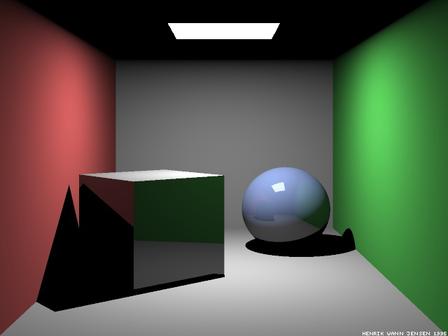
Raytraced Cornell Box
Which paths are missing?
Ray-traced Cornell box, due to Henrik Jensen,
http://www.gk.dtu.dk/~hwj

Slide 52
Paths in RayTracing
Ray Tracing
Captures LDS*E paths: Start at the eye, any number of specular bounces before ending at a diffuse surface and going to the light
Raytracing cannot do:
LS*D⁺E: Light bouncing off a shiny surface like a mirror and illuminating a diffuse surface
LD⁺E: Light bouncing off one diffuse surface to illuminate others
Basic problem: The raytracer doesn’t know where to send rays out of the diffuse surface to capture the incoming light
Also a problem for rough specular reflection
Fuzzy reflections in rough shiny objects
Need other rendering algorithms that get more paths

Slide 53
A Better Rendered Cornell Box

Slide 54
Level of detail

Slide 55
Mipmaps
Mipmaps: pre-calculated, optimized collections of images that accompany a main texture, intended to increase rendering speed and reduce aliasing artifacts.
Widely used in 3D computer games, flight simulators and other 3D imaging systems.
In use, it is called “mipmapping.”
The letters "MIP" in the name are an acronym of the Latin phrase multum in parvo, meaning "much in little”.

Slide 56
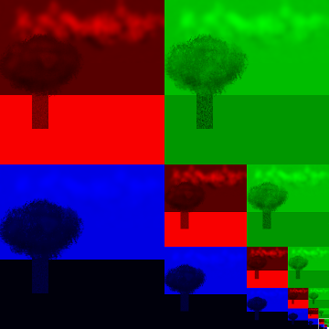
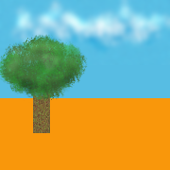
Mipmaps

Slide 57
Level of detail (LOD) techniques
level of detail: decreasing the complexity of some 3D object representations, because they
are far away
are moving fast
are not important
increases the efficiency of rendering by decreasing the workload on graphics pipeline stages
reduced visual quality of the model is often unnoticed because of the small effect on object appearance when distant or moving fast.

Slide 58
Types of LOD
Two types:
Discrete LoD (DLoD)
Continuous LoD (CLoD)

Slide 59
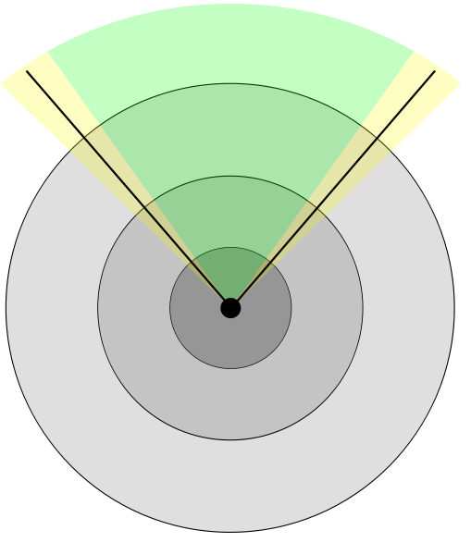
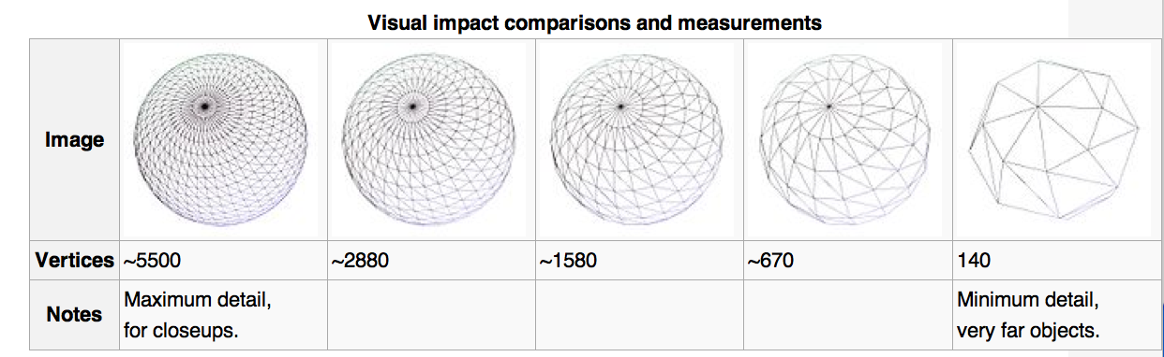
Discrete LoD (DLOD)
Discrete LoD (DLoD)
Make a fixed amount of models, ranging from highest quality to coarse approximation & render appropriate one based on importance factor
Fastest in practice, but leads to “popping”

Slide 60
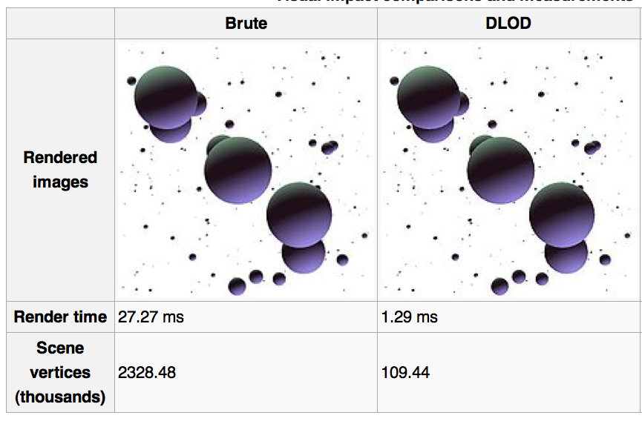
Discrete LoD example

Slide 61
OK, how do we create coarse versions?
How do we take and make these?
Answer: surface decimation

Slide 62


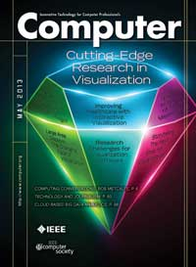
Decimation of Triangle Meshes
Paper by W.J.Schroeder et.al
Presented by Guangfeng Ji

Slide 63
Goal
Reduce the total number of triangles in a triangle mesh
Preserve the original topology and a good approximation of the original geometry

Slide 64
Overview
A multiple-pass algorithm
During each pass, perform the following three basic steps on every vertex:
Classify the local geometry and topology for this given vertex
Use the decimation criterion to decide if the vertex can be deleted
If the point is deleted, re-triangulate the resulting hole.
This vertex removal process repeats, with possible adjustment of the decimation criteria, until some termination condition is met.

Slide 65
Feature Edge
A feature edge exists if the angle between the surface normals of two adjacent triangles is greater than a user-specified “feature angle”.

Slide 66
Characterize Local Geometry and Topology
Each vertex is assigned one of five possible classifications:
Simple vertex
Complex vertex
Boundary vertex
Interior edge vertex
Corner vertex

Slide 67
Evaluate the Decimation Criteria
Complex vertices are not deleted from the mesh.
Use the distance to plane criterion for simple vertices.
Use the distance to edge criterion for boundary and interior edge vertices.
Corner vertex?

Slide 68
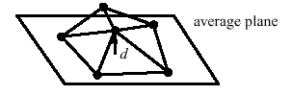
Criterion for Simple Vertices
Use the distance to plane criterion.
If the vertex is within the specified distance to the average plane, it can be deleted. Otherwise, it is retained.

Slide 69
Overview
A multiple-pass algorithm
During each pass, perform the following three basic steps on every vertex:
Classify the local geometry and topology for this given vertex
Use the decimation criterion to decide if the vertex can be deleted
If the point is deleted, re-triangulate the resulting hole.
This vertex removal process repeats, with possible adjustment of the decimation criteria, until some termination condition is met.

Slide 70
Continuous LoD
Continuous LOD (CLoD)
considers the polygon mesh being rendered as a function which must be evaluated requiring to avoid excessive errors which are a function of some heuristic (usually distance) themselves.
The given "mesh" function is then continuously evaluated and an optimized version is produced according to a tradeoff between visual quality and performance.

Slide 71
Terrain Rendering

Slide 72
Terrain rendering
Wikipedia:
Terrain rendering covers a variety of methods of depicting real-world or imaginary world surfaces.
Most common terrain rendering is the depiction of Earth's surface. ← Hank disagrees when it comes to CG
Used in various applications to give an observer a frame of reference

Slide 73
Terrain rendering structure
Actors:
terrain database,
a central processing unit (CPU),
a dedicated graphics processing unit (GPU),
a display.
Software application is configured to start at initial location in the world space.
The output of the application is screen space representation of the real world on a display.

Slide 74
Terrain rendering details
CPU identifies and loads terrain data corresponding to initial location from the terrain database
CPU applies the required transformations to build a mesh of points that can be rendered by the GPU
Data sent to GPU and GPU completes geometrical transformations, creating screen space objects (i.e., polygons) that create a picture closely resembling the location of the real world.

Slide 75
Generation
The main tension is between the # of processed polygons and the # of rendered polygons.
A very detailed picture of the world might use billions of data points.
Virtually all terrain rendering applications use level of detail to manage number of data points processed by CPU and GPU.
There are several modern algorithms for terrain surfaces generating.

Slide 76
Example: ROAM
ROAM: Real-time optimally adapting mesh.
Continuous level of detail algorithm that optimizes terrain meshes.
Premise: sometimes it is more effective to send a small amount of unneeded polygons to the GPU, rather than burden the CPU with LOD (Level of Detail) calculations.
Result: produce high quality displays while being able to maintain real-time frame rates.
ROAM provides control over scene quality versus performance in order to provide HQ scenes while retaining real-time frame rates on hardware.

Slide 77
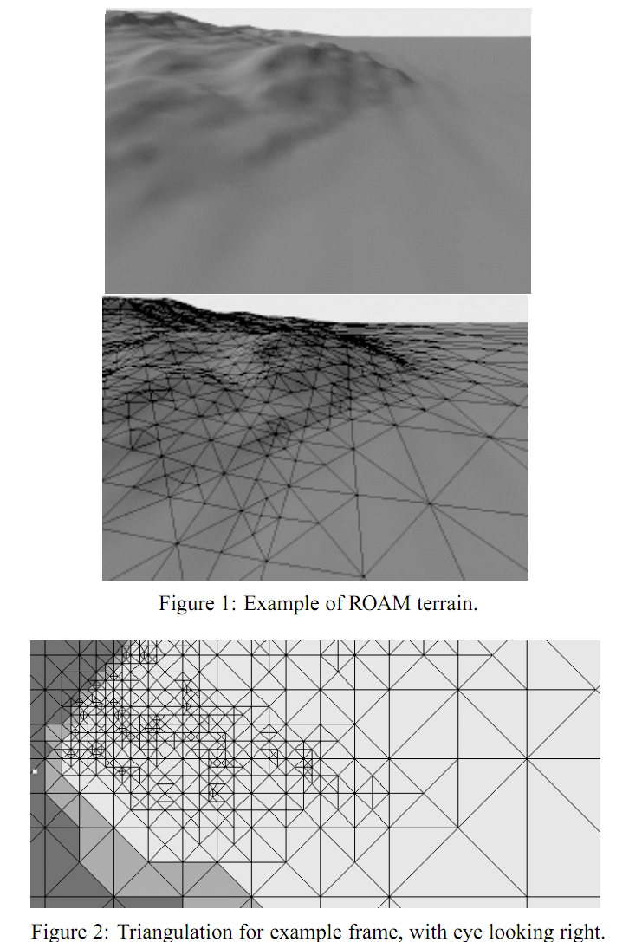
ROAM in action

Slide 78
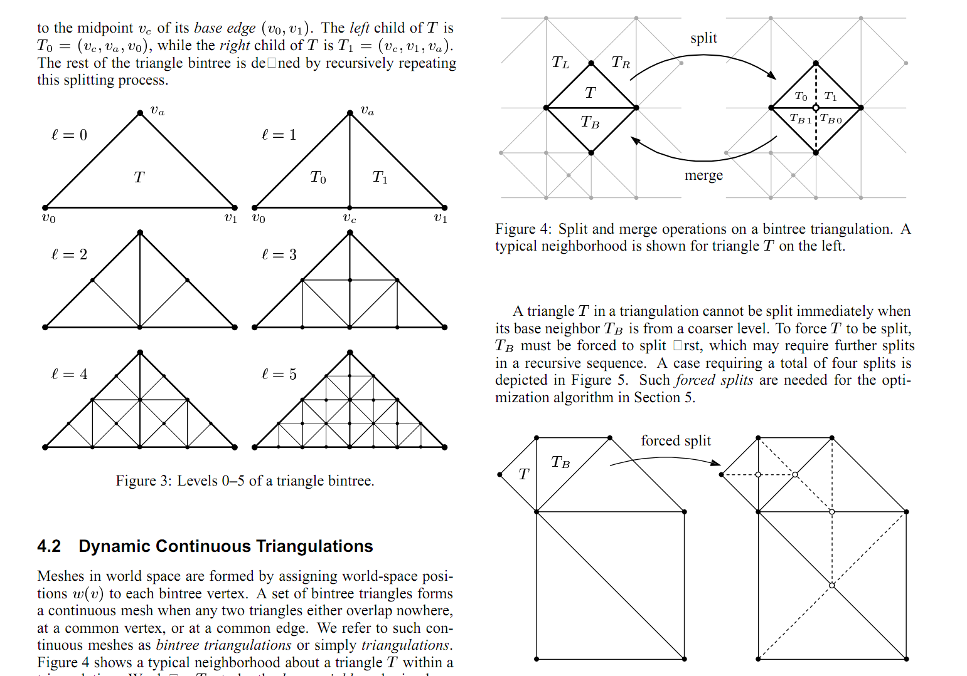
ROAM internals

Slide 79
Spatial Search Structures

Slide 80
Spatial Search Data Structures
Organize geometry so you can quickly find geometry in a given region.
Examples:
Octree
k-d tree
Binary space partitioning
Usages:
Collision detection
Culling
Ray tracing

Slide 81
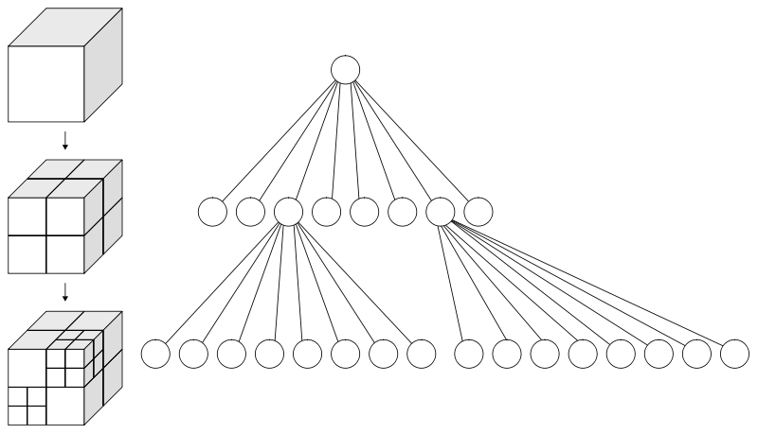
Octrees
Oct + tree = octree (one ‘t’)
Tree data structure
Internal node: has eight children, corresponding to 8 octants
Leaf node: contains some number of points

Slide 82
k-d trees
k-d = k-dimensional tree
We are interested in k=3
Node roles:
Every leaf node is a point
Every internal node divides space into two parts using a plane. Also contains a point.
Each plane is axis-aligned, i.e., X=a, Y=b, or Z=c.
Alternate between axes as you descend the tree

Slide 83
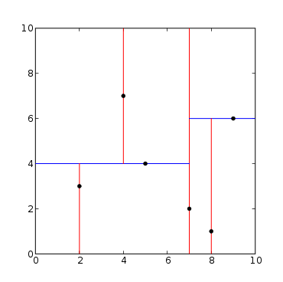
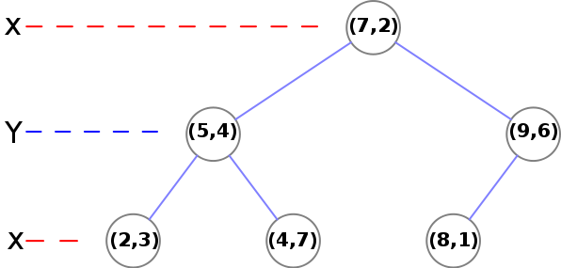
k-d tree

Slide 84
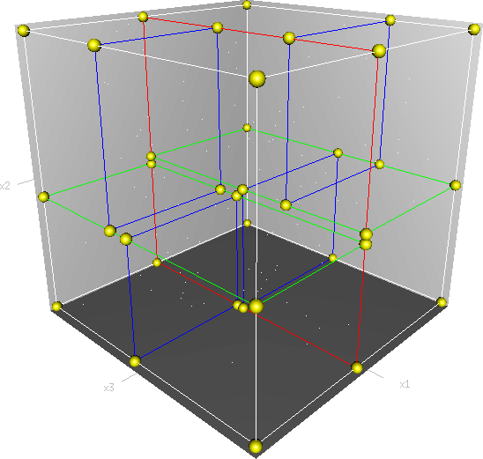
k-d tree

Slide 85
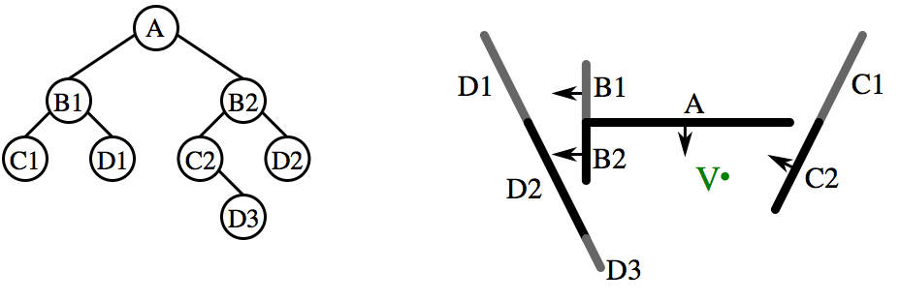
Binary Space Partitioning
General form of k-d trees, using arbitrary planes, not just X=a, Y=b, Z=c
Associated tree (BSP trees) can be used for spatial searches.

Slide 86
View Frustum Culling

Slide 87
View Frustum Culling
Viewing frustum culling: the process of removing objects that lie completely outside the viewing frustum from the rendering process.
Rendering these objects would be a waste of time since they are not directly visible.

Slide 88
View Frustum Culling
Spatial search structures (octree, k-d, BSP) can dramatically accelerate view frustum culling.
Need correct granularity though.
Speedups are very application-dependent
Best case scenario: you are zoomed in on very complex scene
Worst case scenario: you are zoomed out on simple scene

Slide 89
Collision Detection

Slide 90
Collision Detection
Collision detection: as objects in the scene move, figure out when they collide and perform appropriate action (typically bouncing)
Game setting: 30 FPS, meaning 0.033s to figure out what to render and render it.
Use spatial structures to accelerate searching

Slide 91
Collision Detection
Two flavors:
A priori
before the collision occurs
calculate the trajectory of each object and put in collision events right before they occur
A posteriori
after the collision occurs
with each advance, see if anything has hit or gotten close
Both use spatial search structures (octree, k-d tree to identify collisions)

Slide 92
Shaders

Slide 93
Shaders
Shader: computer program used to do “shading”
“Shading”: general term that covers more than just shading/lighting
Used for many special effects
Increased control over:
position, hue, saturation, brightness, contrast
For:
pixels, vertices, textures

Slide 94
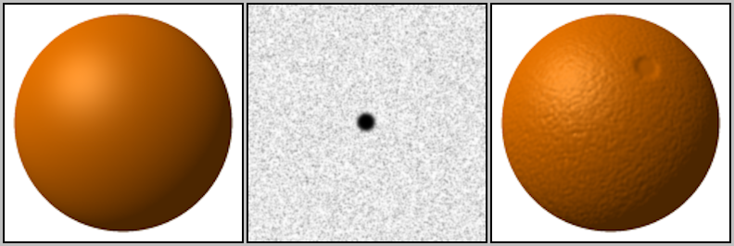
Motivation: Bump Mapping
Idea:
typical rasterization, calculate fragments
fragments have normals (as per usual)
also interpolate texture on geometry & fragments
use texture for “bumps”
take normal for fragment and displace it by “bump” from texture
image from wikipedia

Slide 95
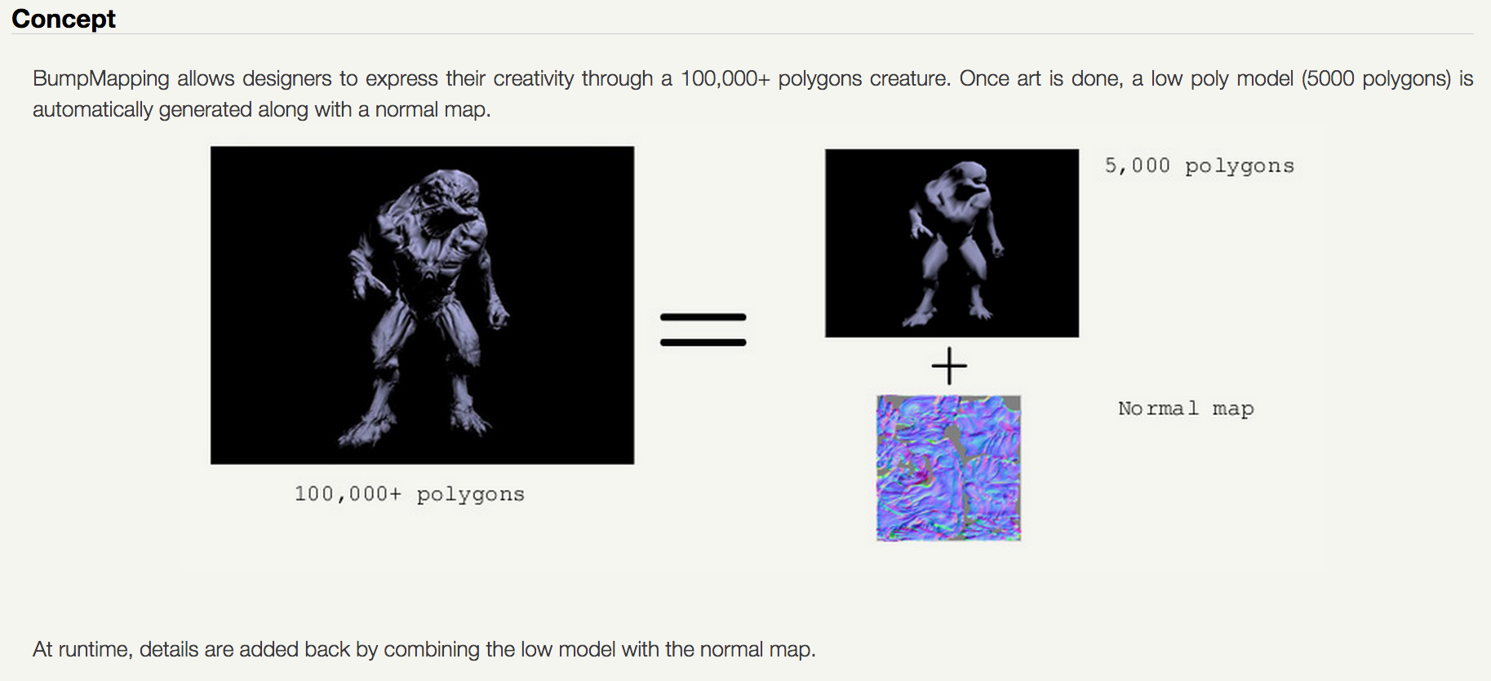
Bump Mapping Example
credit: http://www.fabiensanglard.net/bumpMapping/

Slide 96
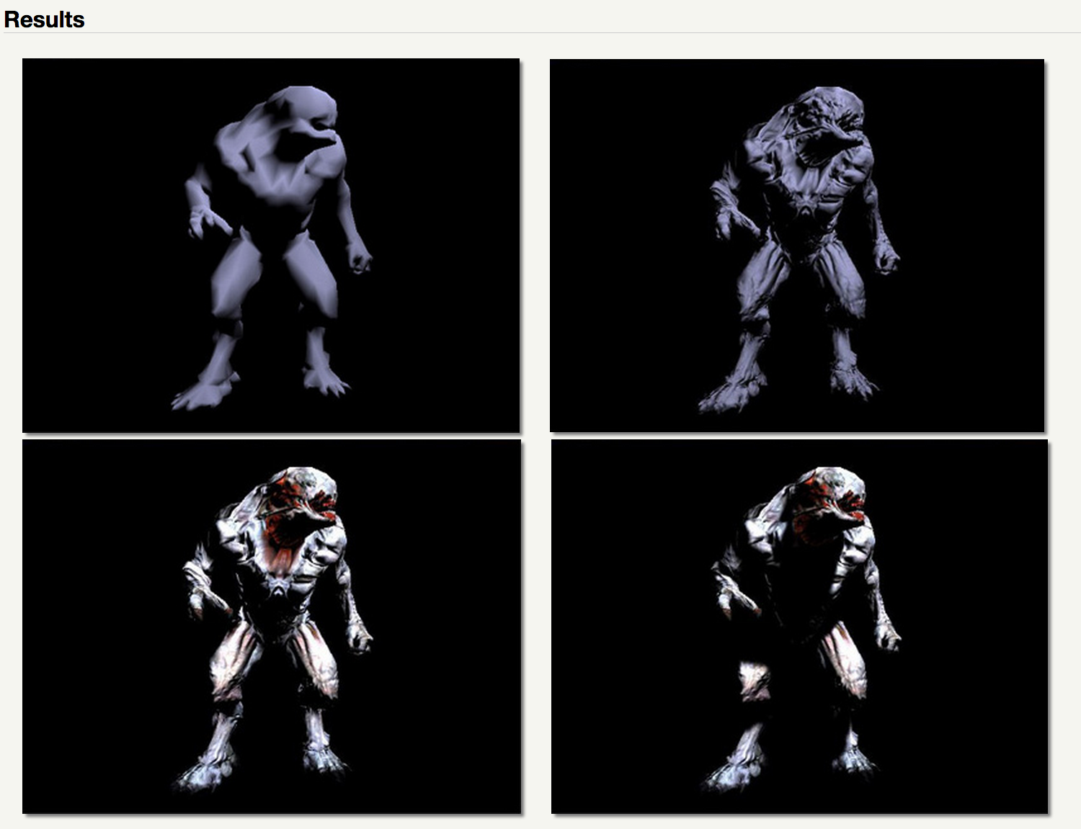
Bump Mapping Example

Slide 97
How to do Bump Mapping?
Answer: easy to imagine doing it in your Project 1A-1F infrastructure
You have total control
But what OpenGL commands would do this?
Not possible in V1 of the GL interface, which is what we have learned
It is possible with various extensions to OpenGL
We will learn to do this with shaders

Slide 98
Shading Languages
shading language: programming language for graphics, specifically shader effects
Benefits: increased flexibility with rendering
OpenGL (as we know it so far): fixed transformations for color, position, of pixels, vertices, and textures.
Shader languages: custom programs, custom effects for color, position of pixels, vertices, and textures.

Slide 99
ARB assembly language
ARB: low-level shading language
at same level as assembly language
Created by OpenGL Architecture Review Board (ARB)
Goal: standardize instructions for controlling GPU
Implemented as a series of extensions to OpenGL
You don’t want to work at this level, but it was an important development in terms of establishing foundation for today’s technology

Slide 100
GLSL: OpenGL Shading Language
GLSL: high-level shading language
also called GLSLang
syntax similar to C
Purpose: increased control of graphics pipeline for developers, but easier than assembly
This is layer where developers do things like “bump mapping”
Benefits:
Benefits of GL (cross platform: Windows, Mac, Linux)
Support over GPUs (NVIDIA, ATI)
HW vendors support GLSL very well

Slide 101
Other high-level shading languages
Cg (C for Graphics)
based on C programming language
outputs DirectX or OpenGL shader programs
deprecated in 2012
HLSL (high-level shading language)
used with MicroSoft Direct3D
analogous to GLSL
similar to CG
RSL (Renderman Shading Language)
C-like syntax
for use with Renderman: Pixar’s rendering engine

Slide 102
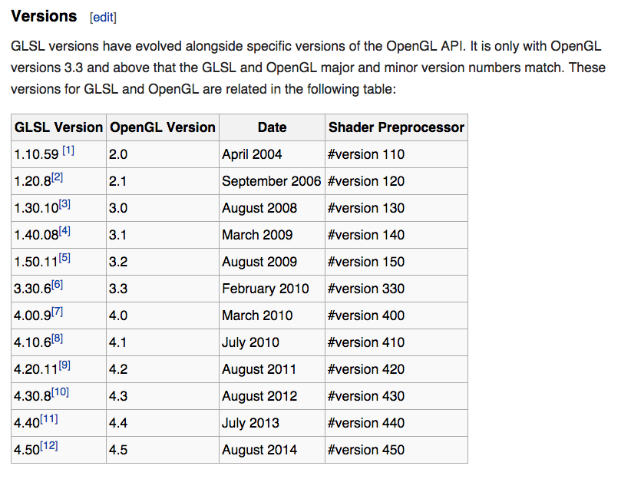
Relationship between GLSL and OpenGL
Source: wikipedia

Slide 103
4 Types of Shaders
Vertex Shaders
Fragment Shaders
Geometry Shaders
Tessellation Shaders
It is common to use multiple types of shaders in a program and have them interact.

Slide 104
How Shaders Fit Into the Graphics Pipeline
You can 0 or 1 of each shader type
Vertex & fragment: very common
Geometry & tessellation: less common
adaptive meshing
Transform Vertices from World Space to Device Space
Rasterize
Contribute Fragments to Buffers
vertex shaders: custom implementation
fragment shaders: custom implementation
geometry & tessellation shaders: create new geometry before rasterized

Slide 105
Vertex Shader
Run once for each vertex
Can: manipulate position, color, texture
Cannot: create new vertices
Primary purpose: transform from world-space to device-space (+ depth for z-buffer).
However: A vertex shader replaces the transformation, texture coordinate generation and lighting parts of OpenGL, and it also adds texture access at the vertex level
Output goes to geometry shader or rasterizer

Slide 106
Geometry Shader
Run once for each geometry primitive
Purpose: create new geometry from existing geometry.
Output goes to rasterizer
Examples: glyphing, mesh complexity modification
Formally available in GL 3.2, but previously available in 2.0+ with extensions
Tessellation Shader: doing some of the same things
Available in GL 4.0

Slide 107
Fragment Shader
Run once for each fragment
Purpose: replaces the OpenGL 1.4 fixed-function texturing, color sum and fog stages
Output goes to buffers
Example usages: bump mapping, shadows, specular highlights
Can be very complicated: can sample surrounding pixels and use their values (blur, edge detection)
Also called pixel shaders

Slide 108
How to Use Shaders
You write a shader program: a tiny C-like program
You write C/C++ code for your application
Your application loads the shader program from a text file
Your application sends the shader program to the OpenGL library and directs the OpenGL library to compile the shader program
If successful, the resulting GPU code can be attached to your (running) application and used
It will then supplant the built-in GL operations

Slide 109
How to Use Shaders: Visual Version
sends “char *”
version of
program to GL via
function call
Project2B’
C++ code
Project2B’
binary
g++
OpenGL
library
reads
text
file
when
running
OpenGL
compiles program, binary made just for
the current
execution
Program is used
on GPU to support
Project2B’ binary
shader program is a binary
shader program

Slide 110
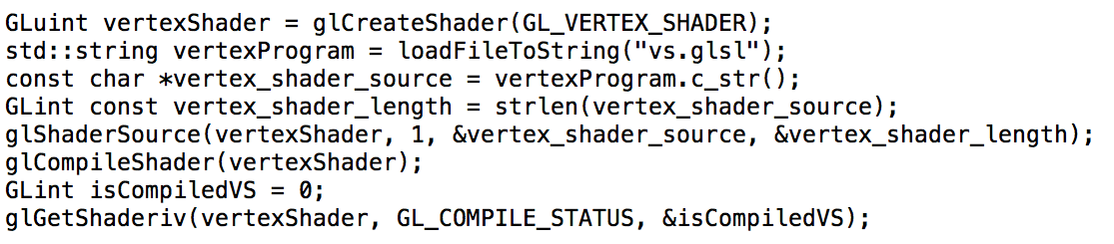
Compiling Shader

Slide 111
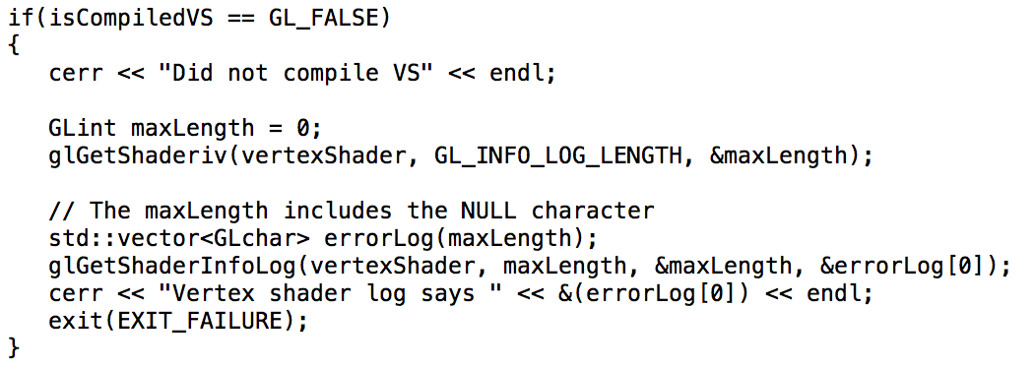
Compiling Shader: inspect if it works

Slide 112
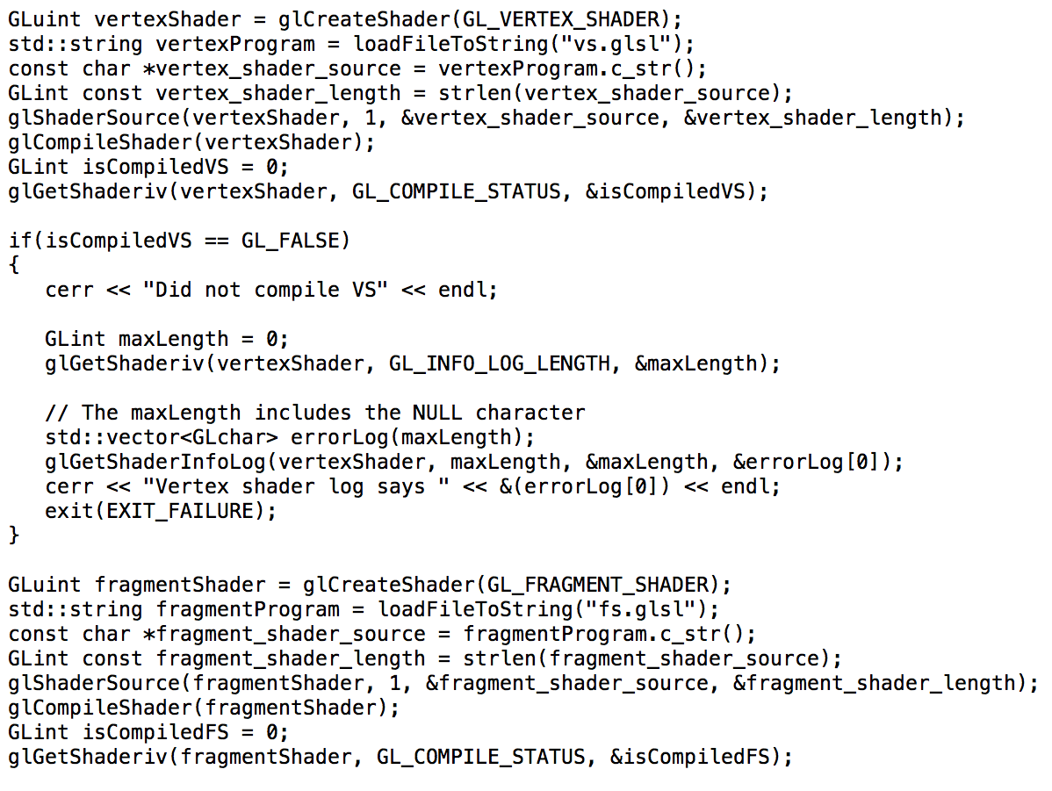
Compiling Multiple Shaders

Slide 113
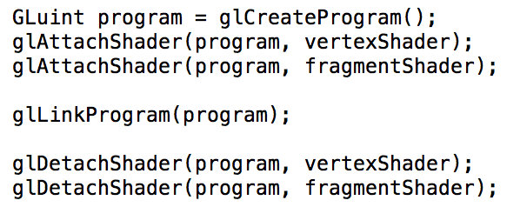
Attaching Shaders to a Program

Slide 114
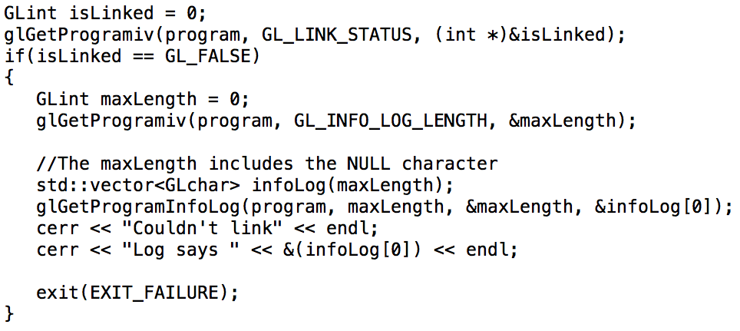
Inspecting if program link worked…

Slide 115
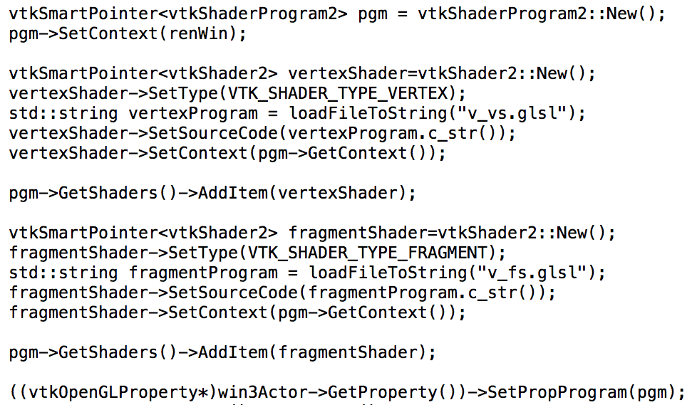
BUT: this doesn’t work in VTK…
VTK has its own shader handling, and it doesn’t play well with the GL calls above…
note: VTK6.1 much better for shaders than 6.0

Slide 116
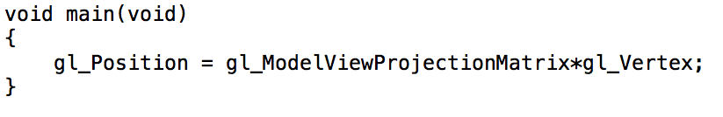
Simplest Vertex Shader
Many built-in variables.
Some are input.
Some are required output (gl_Position).

Slide 117
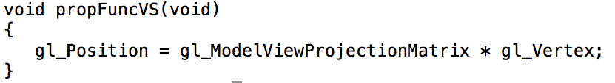
Simplest Vertex Shader (VTK version)
VTK uses special names
propFuncVS: vertex shader
propFuncFS: fragment shader
somehow it changes these into “main” just in time…

Slide 118
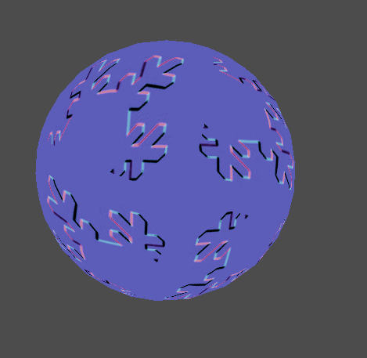
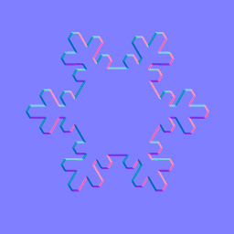
Bump-mapping with GLSL
bump map texture
output

Slide 119

Will need to load a texture…

Slide 120



Need to put 2D textures on our triangles…

Slide 121

Need to set up shaders and textures…

Slide 122

So what is the vertex shader program?...

Slide 123

And what is the fragment shader program?...

Slide 124
Rotations

Slide 125

Improved rotations
Project 2A/2B:
Click here
→
Medium rotations
around combination of up & “up cross view” for as long as you hold button down.
Click here
→
Large rotations
around “up cross view” for as long as you hold button down.
Click here
→
Small rotations
around up axis for as long as you hold button down.
Click here
→
Large rotations
around up axis for as long as you hold button down.

Slide 126

Improved rotations: trackball
Only rotates while trackball is spun

Slide 127
Improved rotations: trackball
Idea: approximate trackball interface with traditional mouse interface
Camera movement occurs when the mouse is moving
The camera does not move when the button is clicked, but the mouse does not move

Slide 128
Improved rotations: trackball
Imagine your scene is contained within a sphere.
When you push the mouse button, the cursor is over a pixel and the ray corresponding to that pixel intersects the sphere.
Idea: every subsequent mouse movement (while the button is pushed) should rotate the intersection of the sphere so that it is still under the cursor.

Slide 129
Improved rotations: trackball
Click here
Move mouse here
Then sphere should move too

Slide 130
How to do the rotations?
Best way: use quaternions
Number system that extends complex numbers
Applies to mechanics to 3D space
Would be a very long lecture!
Simple way:
Take “dx” and “dy” in pixels, and then do
RotateAroundUp(dy*factor);
RotateAroundUpCrossView(dx*factor);
Factors vary based on level of zoom
Can create weird effects based on order of rotations
Users rarely notice in practice

Slide 131
Parallel Renderin

Slide 132




Large Scale Visualization with Cluster Computing
Linux Cluster Institute Workshop
October 1, 2004
Kenneth Moreland
Sandia National Laboratories
Sandia is a multiprogram laboratory operated by Sandia Corporation, a Lockheed Martin Company, for the United States Department of Energy’s National Nuclear Security Administration under contract DE-AC04-94AL85000.

Slide 133
The Graphics Pipeline
Points
Lines
Polygons
Rendering Hardware
Geometric Processing
Translation
Lighting
Clipping
Rasterization
Polygon Filling
Interpolation
Texture Application
Hidden Surface Removal
Frame Buffer
Display

Slide 134
Parallel Graphics Pipelines
Points
Lines
Polygons
Each loaded/calculated individually
Rendering Hardware
Geometric Processing
Translation
Lighting
Clipping
Rasterization
Polygon Filling
Interpolation
Texture Application
Hidden Surface Removal
Frame Buffer
Display

Slide 135

Parallel Graphics Pipelines
FB
G
R
FB
G
R
FB
G
R
FB
G
R

Slide 136
Sort Middle Parallel Rendering
Sorting Network
G
R
FB
FB
G
R
FB
FB
G
R
G
R

Slide 137
Sort First Parallel Rendering
Sorting Network
G
R
FB
FB
G
R
FB
FB
G
R
G
R

Slide 138
Sort Last Parallel Rendering
Sorting Network
G
R
G
R
FB
G
R
G
R

Slide 139
Sort-First Bottleneck
Polygon Sorter
Renderer
Polygon Sorter
Renderer
Network
Polygon Sorter
Renderer
Polygon Sorter
Renderer

Slide 140
Sort-Last Bottleneck
Renderer
Renderer
Composition Network
Renderer
Renderer

Slide 141
Clockwise / Counter-Clockwise

Slide 142



What is going on here?
Details:
Diffuse = 0.8, ambient = 0.2
Default GL normal is (0,0,1)

Slide 143
But wait…
If you have an open surface, then there is a “back face”.
The back face has the opposite normal.
How can we deal with this case?
Idea #1: encode all triangles
twice, with different normals
Idea #2: modify diffuse lighting model
Diffuse light = abs(L.N)
This is called two-sided lighting

Slide 144
Reminder: open surface, closed surface
Closed surface:
you could drop it in water and it would float (i.e., no way for water to get inside)
no way to see the inside
Open surface:
water can get to any part of the surface
you can see the inside

Slide 145
Front face / back face
Front face: the face that is “facing outward”
Back face: the face that is “facing inward”
These distinctions are meaningful for closed surfaces
They are not meaningful for open surfaces
This is why we did “two-sided lighting”

Slide 146
What is going on here?
Answer:
OpenGL is giving us diffuse+ambient on the left, but only ambient on the right (rather, diffuse == 0).
Why? … it is interpreting the left side as a “front face” and the right side as a “back face”.
(if we spun the camera, the left would be gray, and the right would be white)

Slide 147
Determining Front Face and Back Face
The front face and back face is determined by convention
Convention #1:
V1, V2, and V3 are arranged counter-clockwise around the front-face
V3
Front-face
V1
Back-face
V2

Slide 148
Determining Front Face and Back Face
The front face and back face is determined by convention
Convention #1:
Which vertex is specified first doesn’t matter, as long as they are arranged counter-clockwise around the front-face
V2
Front-face
V3
Back-face
V1

Slide 149
Determining Front Face and Back Face
The front face and back face is determined by convention
Convention #2:
V1, V2, and V3 are arranged clockwise around the front-face
V2
Front-face
V1
Back-face
V3

Slide 150
Determining Front Face and Back Face
The front face and back face is determined by convention
Convention #1: Convention #2:
V3
V2
Front-face
Front-face
V1
V1
Back-face
Back-face
V2
V3

Slide 151

glFrontFace

Slide 152
Why front face / back face is important
Reason #1:
Need to know this if you are doing lighting calculations
Reason #2:
Culling

Slide 153
Culling
Idea: some triangles can’t affect the picture, so don’t render them.
Question: how can this happen?
Answer #1: geometry outside [0->width, 0->height] in device space
Answer #2: closed surface, and the back face is facing the camera

Slide 154


Slide 155

Something you should know about: Left- and right-handed coordinates
OpenGL: right-handed
DirectX: left-handed

